Slide 1


Eco Streets , LLC
For a better Future.
Name | ID
Anas Hamed Mohamed | 4989
Ibrahim Mostafa | 4715
Islam Mustafa | 4595
Mohannad Mahmoud | 5123
Omar Ashraf | 4738
Omar khattab | 5247
Wadie Bishoy | 5074
Karim Raafat Abdelmalek | 2465

Slide 2
Fuel price in Egypt

Slide 3
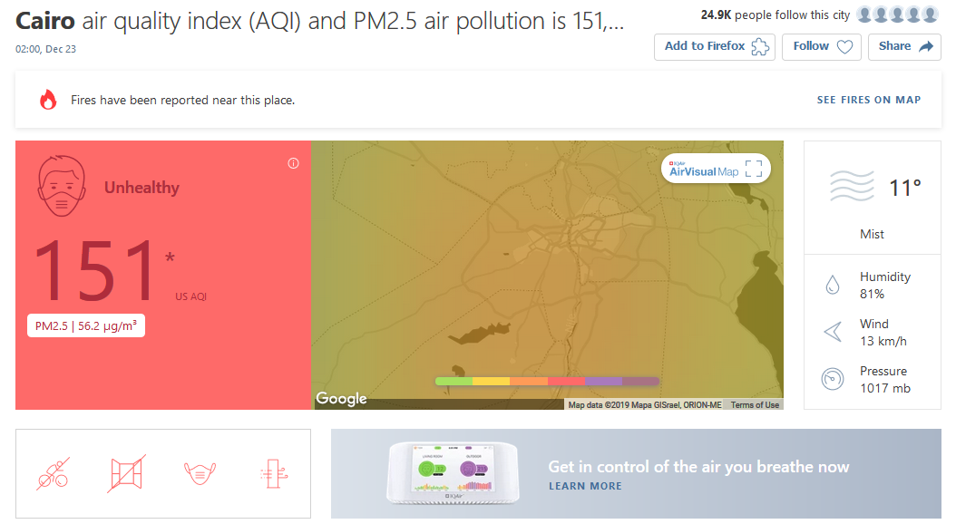

Slide 4
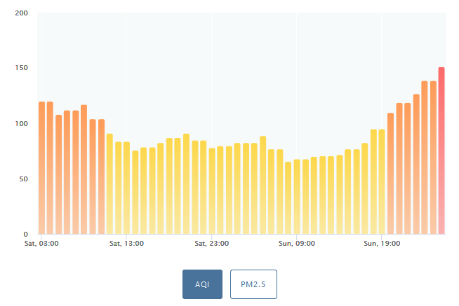
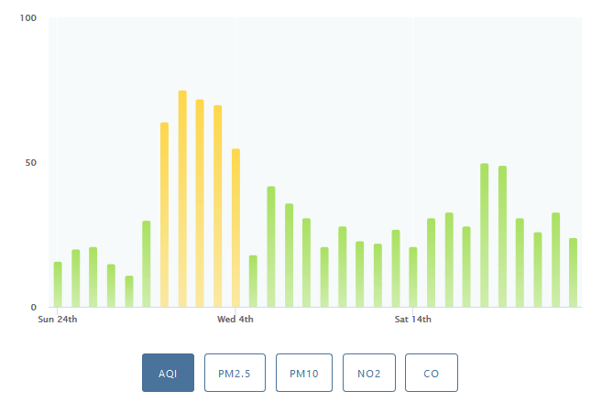
Air quality in Egypt
151
22
Cairo, Egypt air quality index
Oslo, capital of Norway air quality index

Slide 5
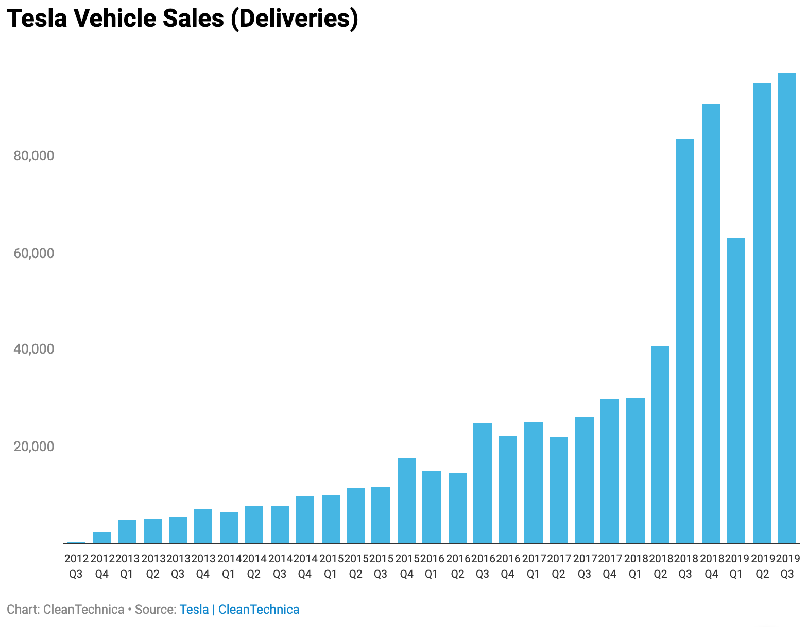
Investment
90,000 unit in 2019
1000 unit in 2013

Slide 6
Going with the modern Flow
Globalization
EVERY BODY IS DOING IT
Modernization
IT IS THE NEW WAY

Slide 7
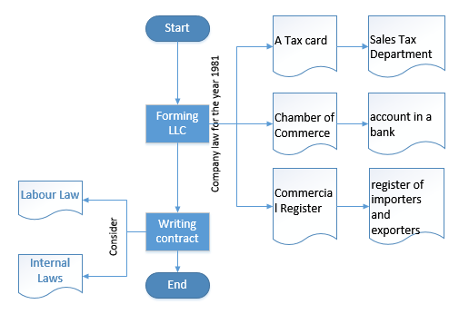
Legal procedures
TAXES MIS-CALCULATION
Traffic Licensing Procedure

Slide 8


Facilitations offered by GAFI
Tax free importing and easier legislation

Slide 9
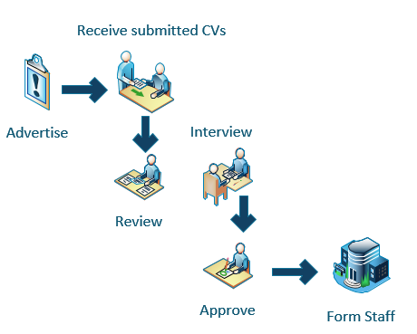
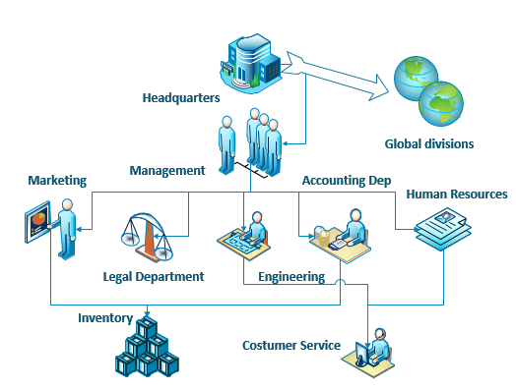
Organizational Study
Staff formation
Management Structure

Slide 10
Marketing Mix
product
Unsought product as people don’t know there importance
price
The market is untapped so we can choose a suitable price
place
Sustainability and increasing awareness + offers
promotion
The new Capital where there is development and opportunity

Slide 11
SWOT Analysis
Strengths
Great technological knowledge of the involved technologies
Leading role in integrating this business in egypt
Weaknesses
Low awareness of The people
Huge Capital needed
Opportunities
The price of the needed technology is getting cheaper
The government offers great facilitations in legal and financial procedure
Threats
The bigger companies in automobile industry can enter the market
Red Tape

Slide 12

Expected Market Share
The new capital is expected to have a population of 20 million by 2050
According to Statistics, 30% of the population will have the capability of purchasing an EV
The expected sales for the 30 years is estimated to be one million vehicles

Slide 13
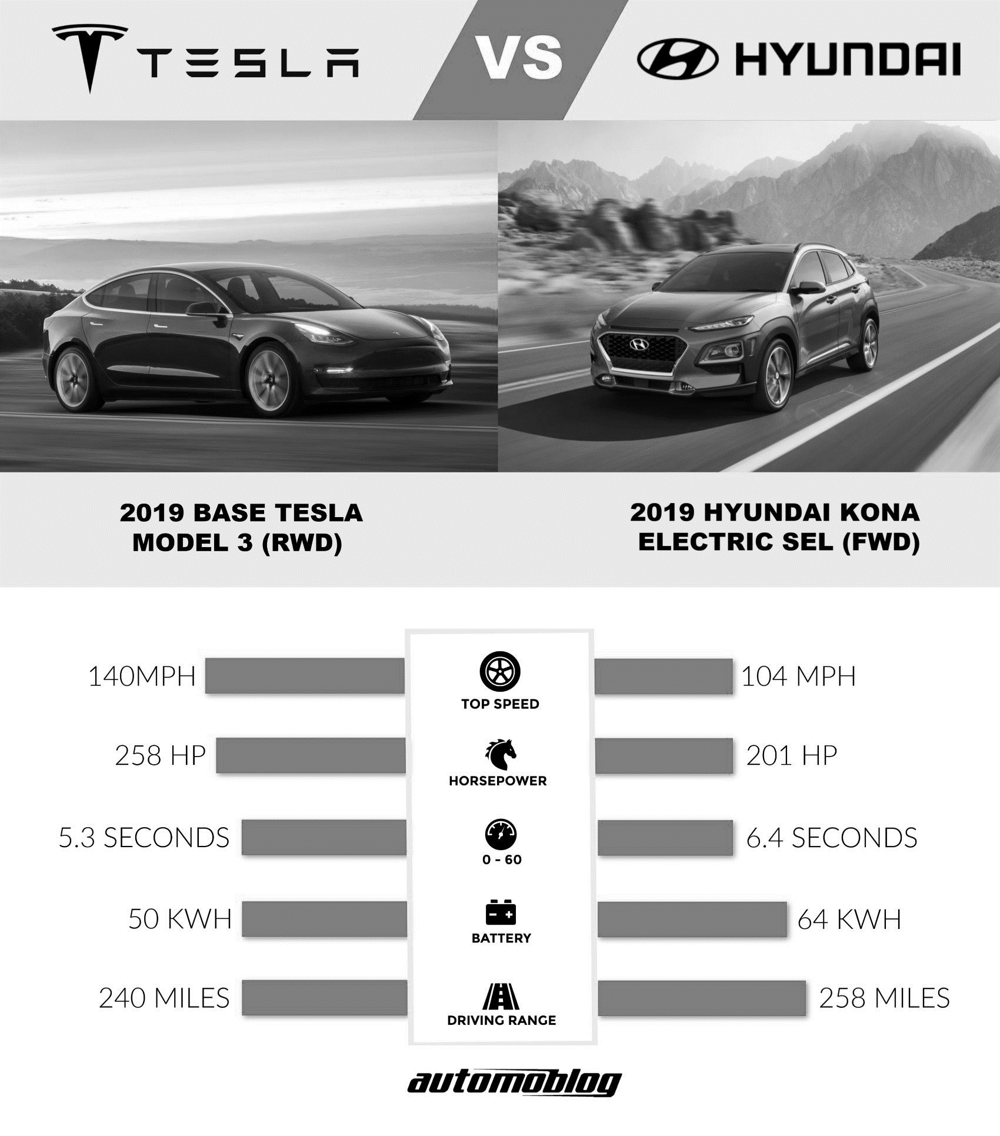
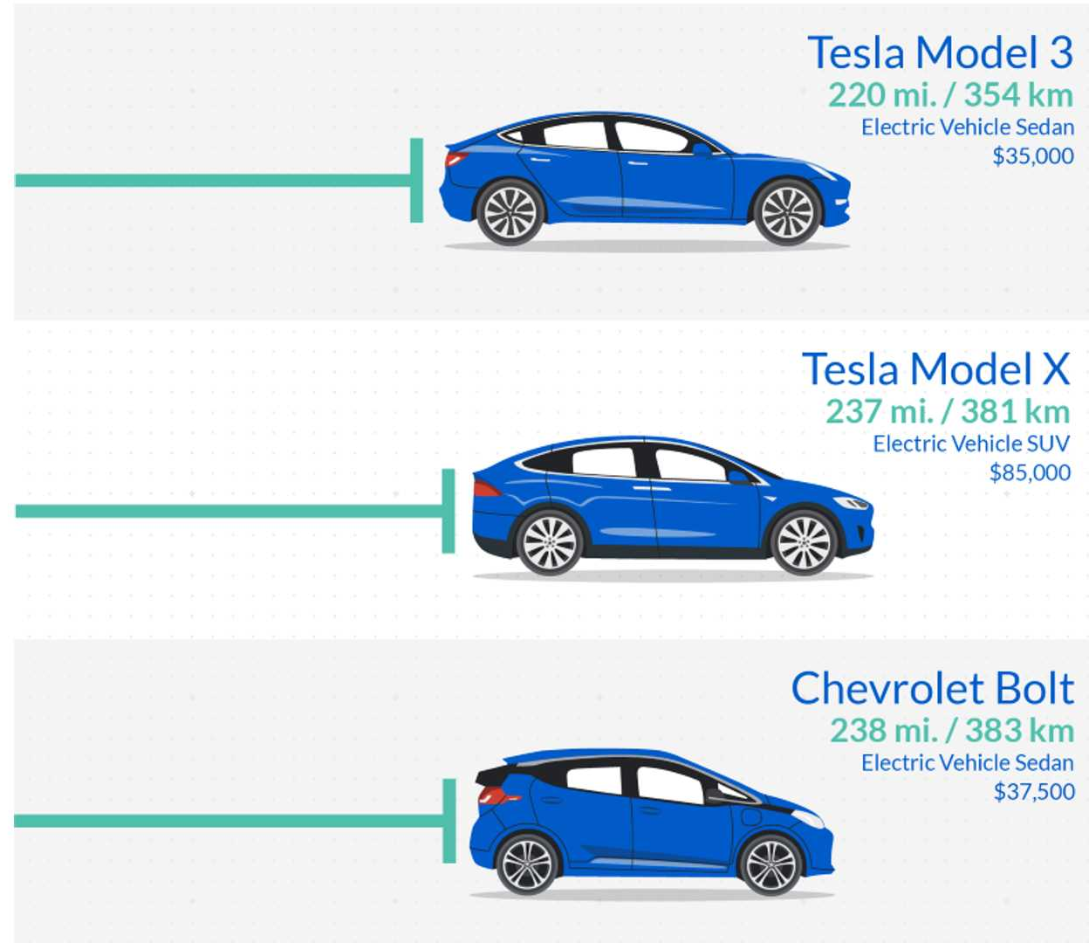
Technical
35,000$
85,000$
37,000$

Slide 14
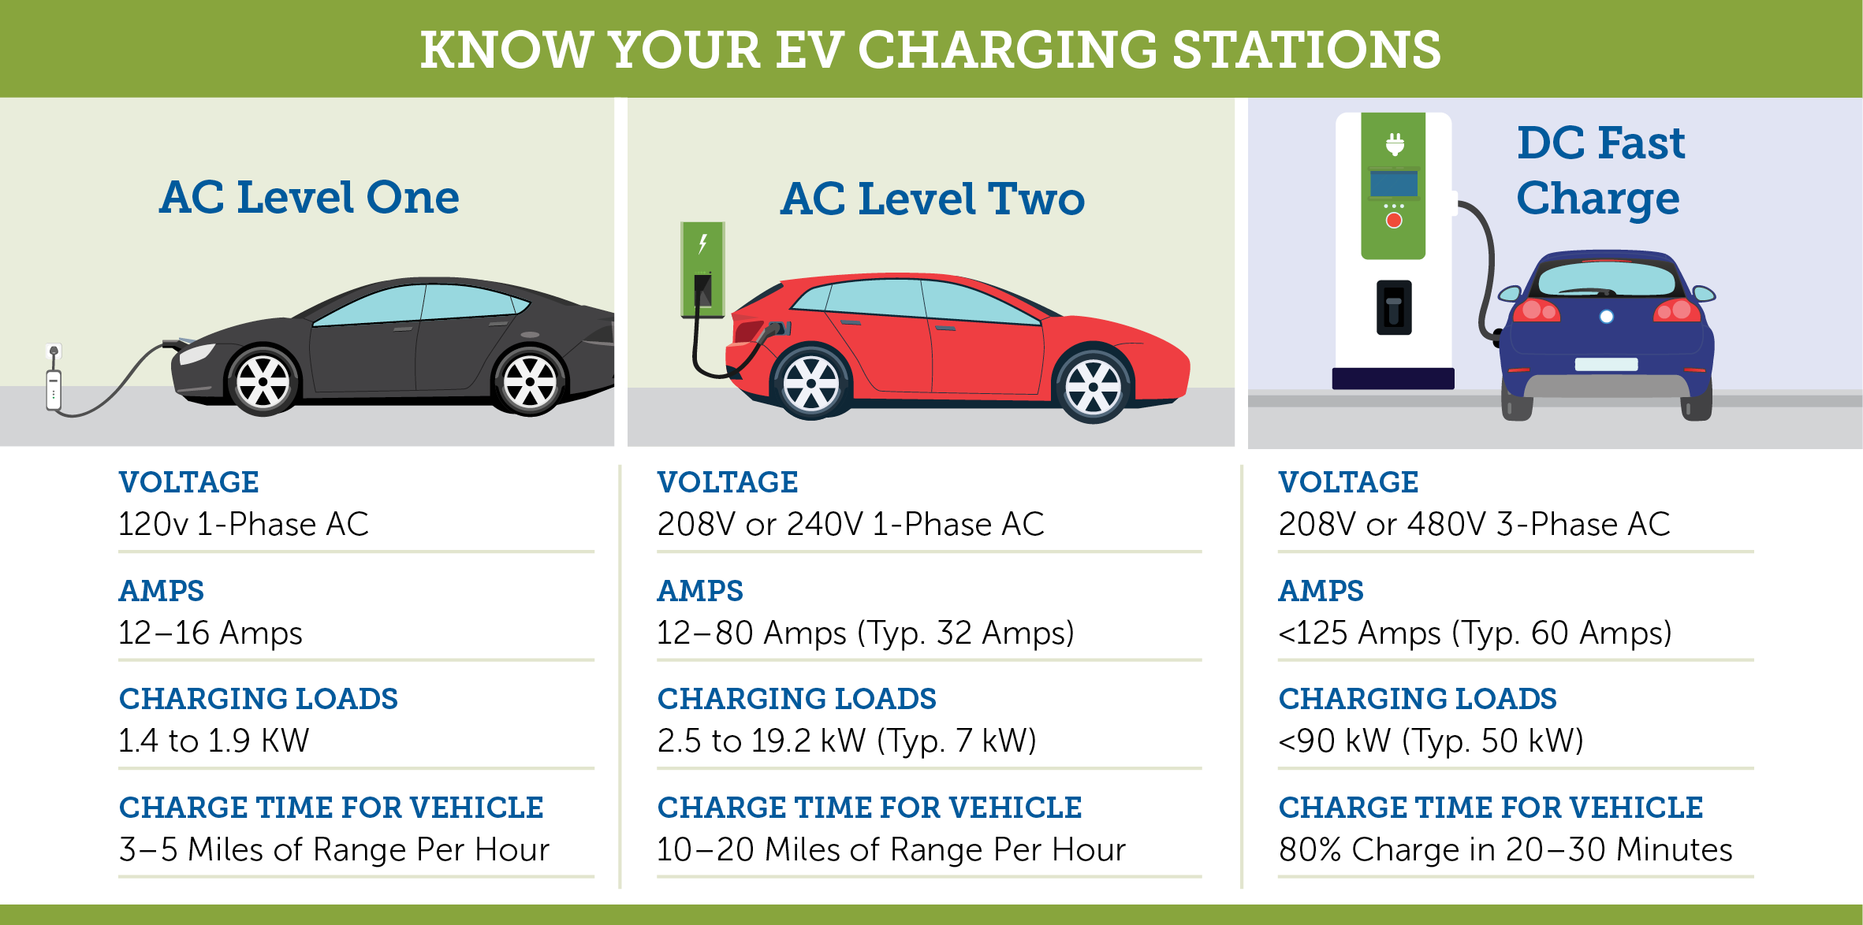
Technical
Know Your EV charging Stations
40 level 2 stations
16,000 EGP per station

Slide 15

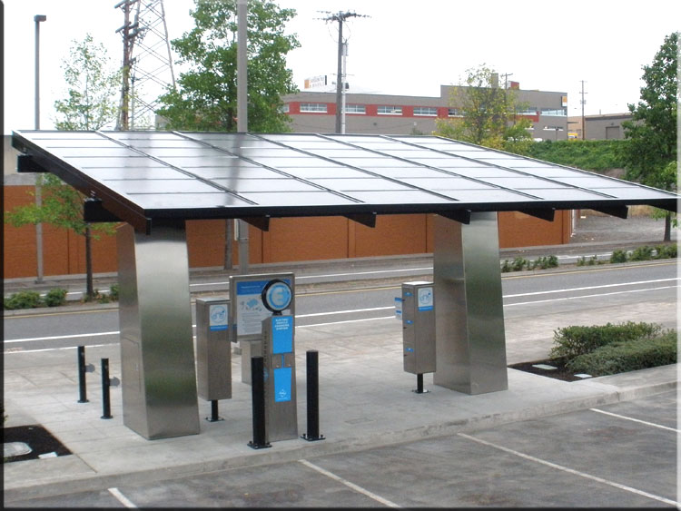
Pv Panels (Imported from jinko)
Monocrystalline Panels (jinko cheetah PERC) with highest modular efficiency (20%) to consume least area
ON-grid system to eliminate price of batteries
0.23$ per watt (3.68 EGP) for huge orders >10KW
7kw charging load = 25,000 EGP
Panel = 335 watt , 20 panels needed (area = 4.5*7)
Total Station cost = 70,000 EGP

Slide 16
Market Entry
Legal procedure Will be Initiated Immediately after the Study reports Feasible Results
We will Start preparing the Infrastructure (charging stations, Headquarters and selling points) by 2023
We hope to be able to enter the market by the Year 2025

Slide 17
Financial Expectations
Item/ | Cost in first stage in EGP
Rent & expenses | 300,000 + 500,000
Salaries | 1,500,000
Stations | 600,000
PV | 1,300,00
TOTAL | 4,200,000
Proposal For bank Loan
CIB has Solar energy loans with low ratesto encourage usage of renewable energy

Slide 18
Financial Expectations
276 unit
Break-Even Point (units) = | 276 |  |  | Break-Even Point ($'s) = | $13,793,103
TFC = | $4,000,000
VCU = | $35,500.00
SPU = | $50,000.00

Slide 19
References
https://www.elwatannews.com/news/details/4248306
https://cleantechnica.com
https://www.airvisual.com
https://www.heritage.org/index/country/egypt
https://www.automoblog.net/2019/05/04/tesla-model-3-hyundai-kona-electric/

